Slide 1
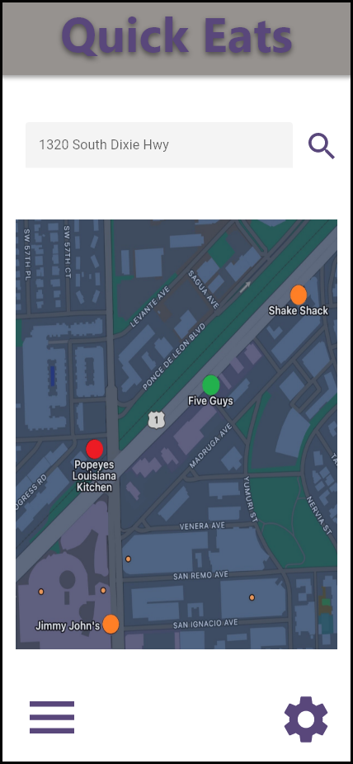
Map View Page
Enter location and click search button
Interactive map, with colors indicating wait times. Click a restaurant for more info
Switch to list view
Map view settings

